Slide 1
Addressing backlogs and managing waiting lists during and beyond the COVID-19 pandemic
Ewout van Ginneken
Hub Coordinator
European Observatory on Health Systems and Policies
Berlin Hub
Berlin University of Technology: Departement of Health Care Management

Slide 2


Slide 3
Introduction
As COVID-19 cases started to rise in early 2020 health systems began to postpone non-emergency (elective) procedures to keep capacity available for COVID-19 patients, and to avoid elective patients being infected.
This has subsequently led to longer waiting lists and waiting times in virtually all countries. The additional cumulated number of patients on the waiting lists due to COVID-19 is commonly referred to as the care backlog.
Each delay in diagnosis and treatment may worsen health prospects

Slide 4
What do we know about service disruptions and backlog?
Services were disrupted in virtually all European countries
While hospital, dental and mental health services were initially disrupted, disruptions gradually affected primary care, as well as emergency care
The degree of disruption decreased towards the end of 2021, but not for all services
Some countries do not systematically monitor waiting times
Countries are challenged by ‘missing’ patients, i.e. patients who were expected to be referred for treatment but did not present during the pandemic

Slide 5
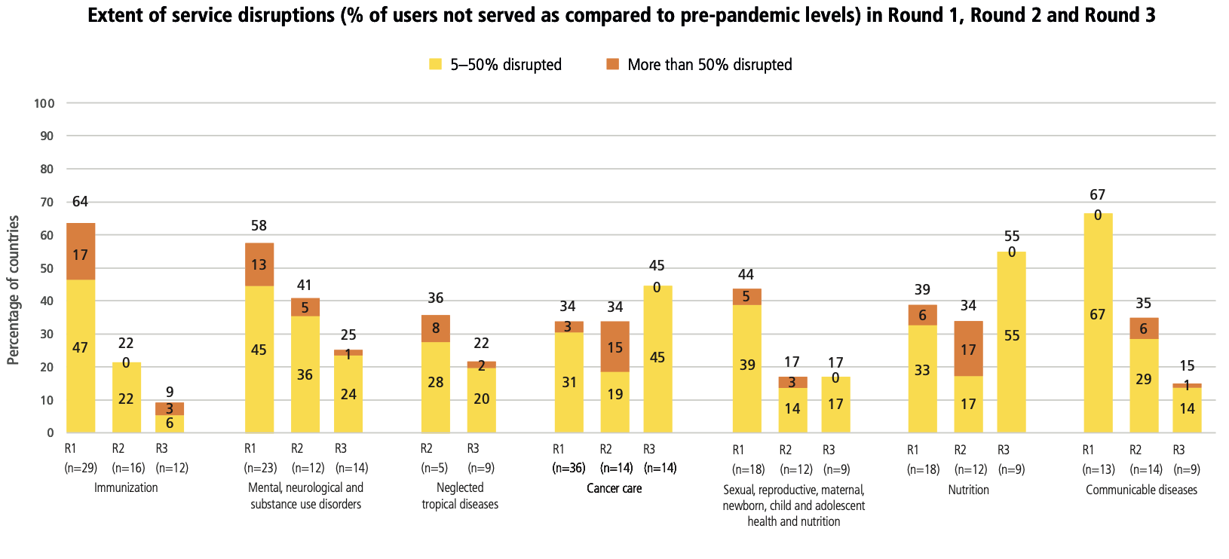
Disruption of cancer care and nutrition services increased in 2021, but declined for other services
Source: WHO, 2022a.

Slide 6
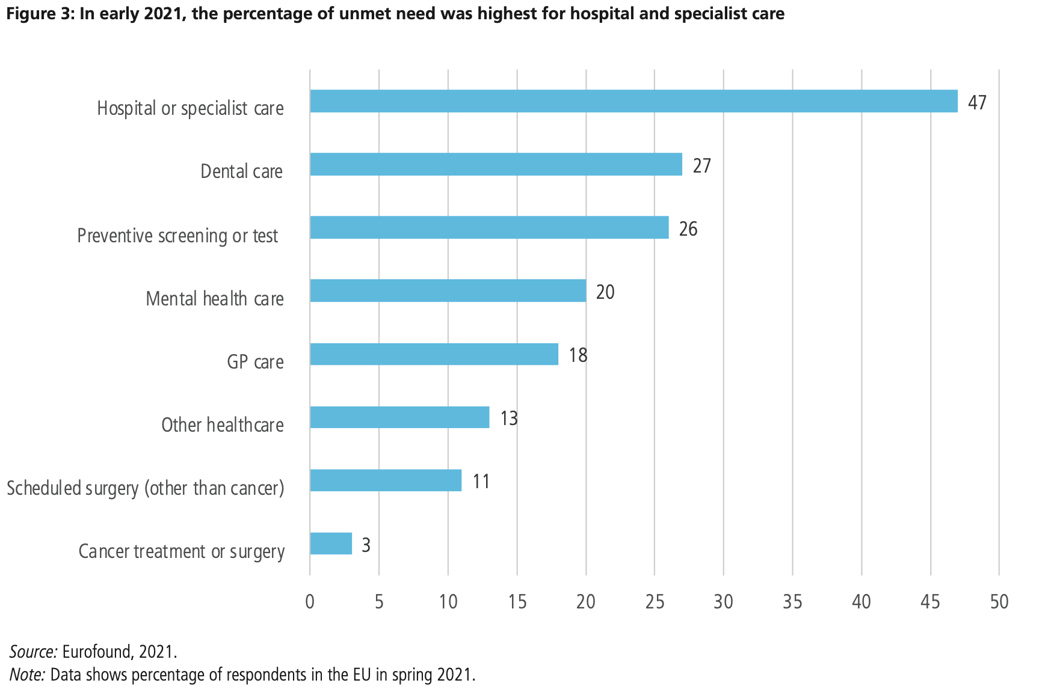
Disruptions have led to high unmet need for care
Over a fifth (21%) of EU citizens had missed a medical examination or treatment

Slide 7
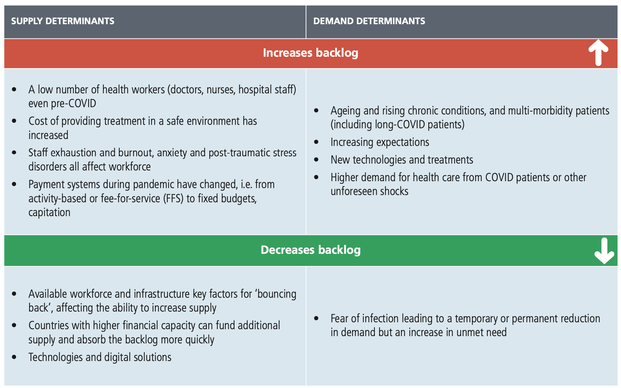
What are the drivers of backlog?

Slide 8
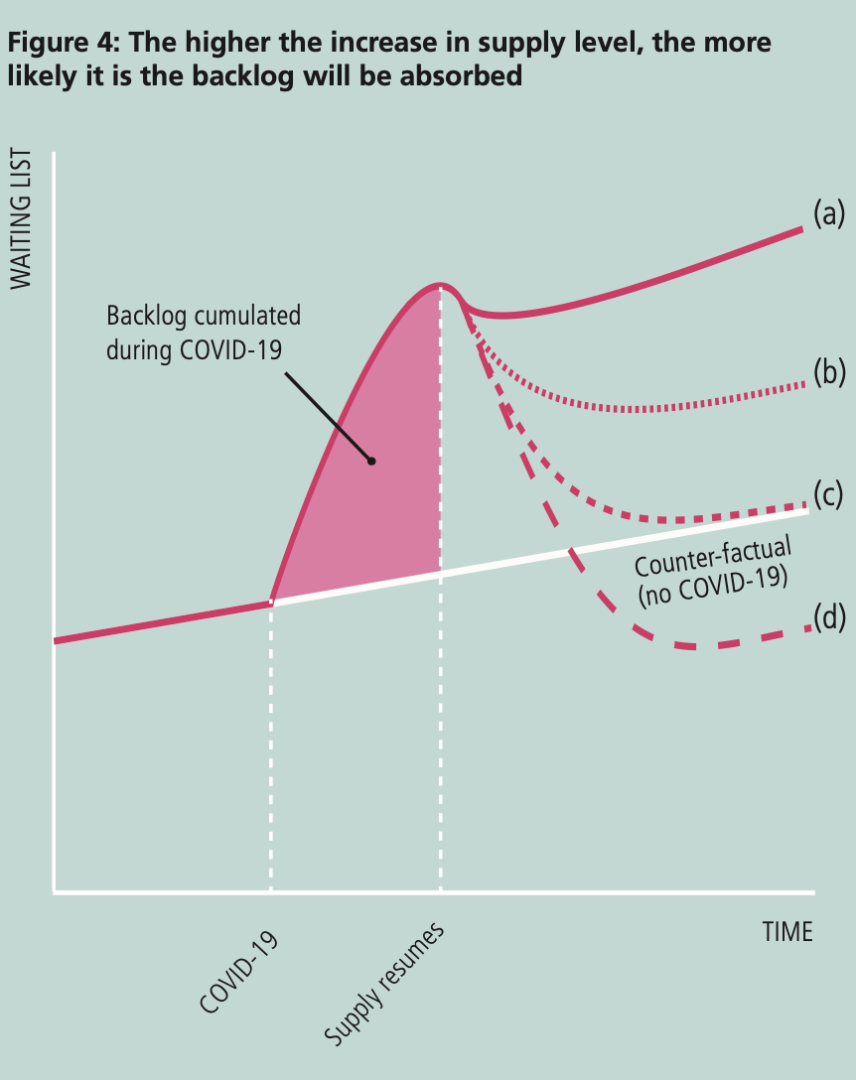
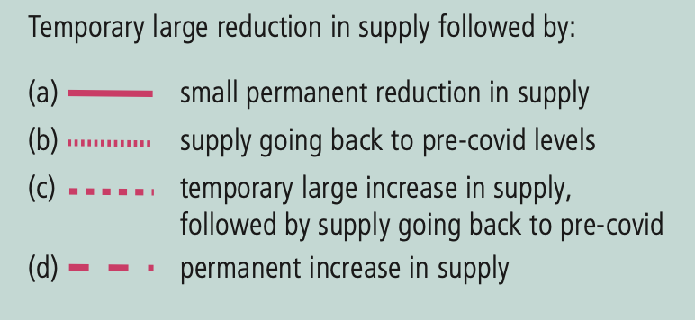
Bringing back provision to previous levels will not be enough to overcome the backlogs
Existence of pre-pandemic waiting times and the increase in the number of patients on the waiting lists during the pandemic mean that returning to previous levels will not be enough to overcome the backlogs.
This emphasizes the critical role of resuming supply at different levels

Slide 9
Which policies are countries using to tackle backlogs?
Three broad strategies visible
Increasing the supply of workforce and staffing
Improving productivity, capacity management and demand management
Investing in capital, infrastructure and new community-based models of care

Slide 10
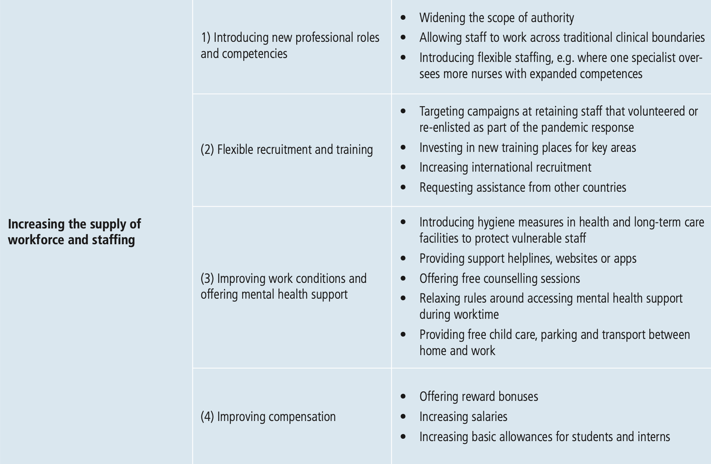
Increasing the supply of workforce and staffing

Slide 11
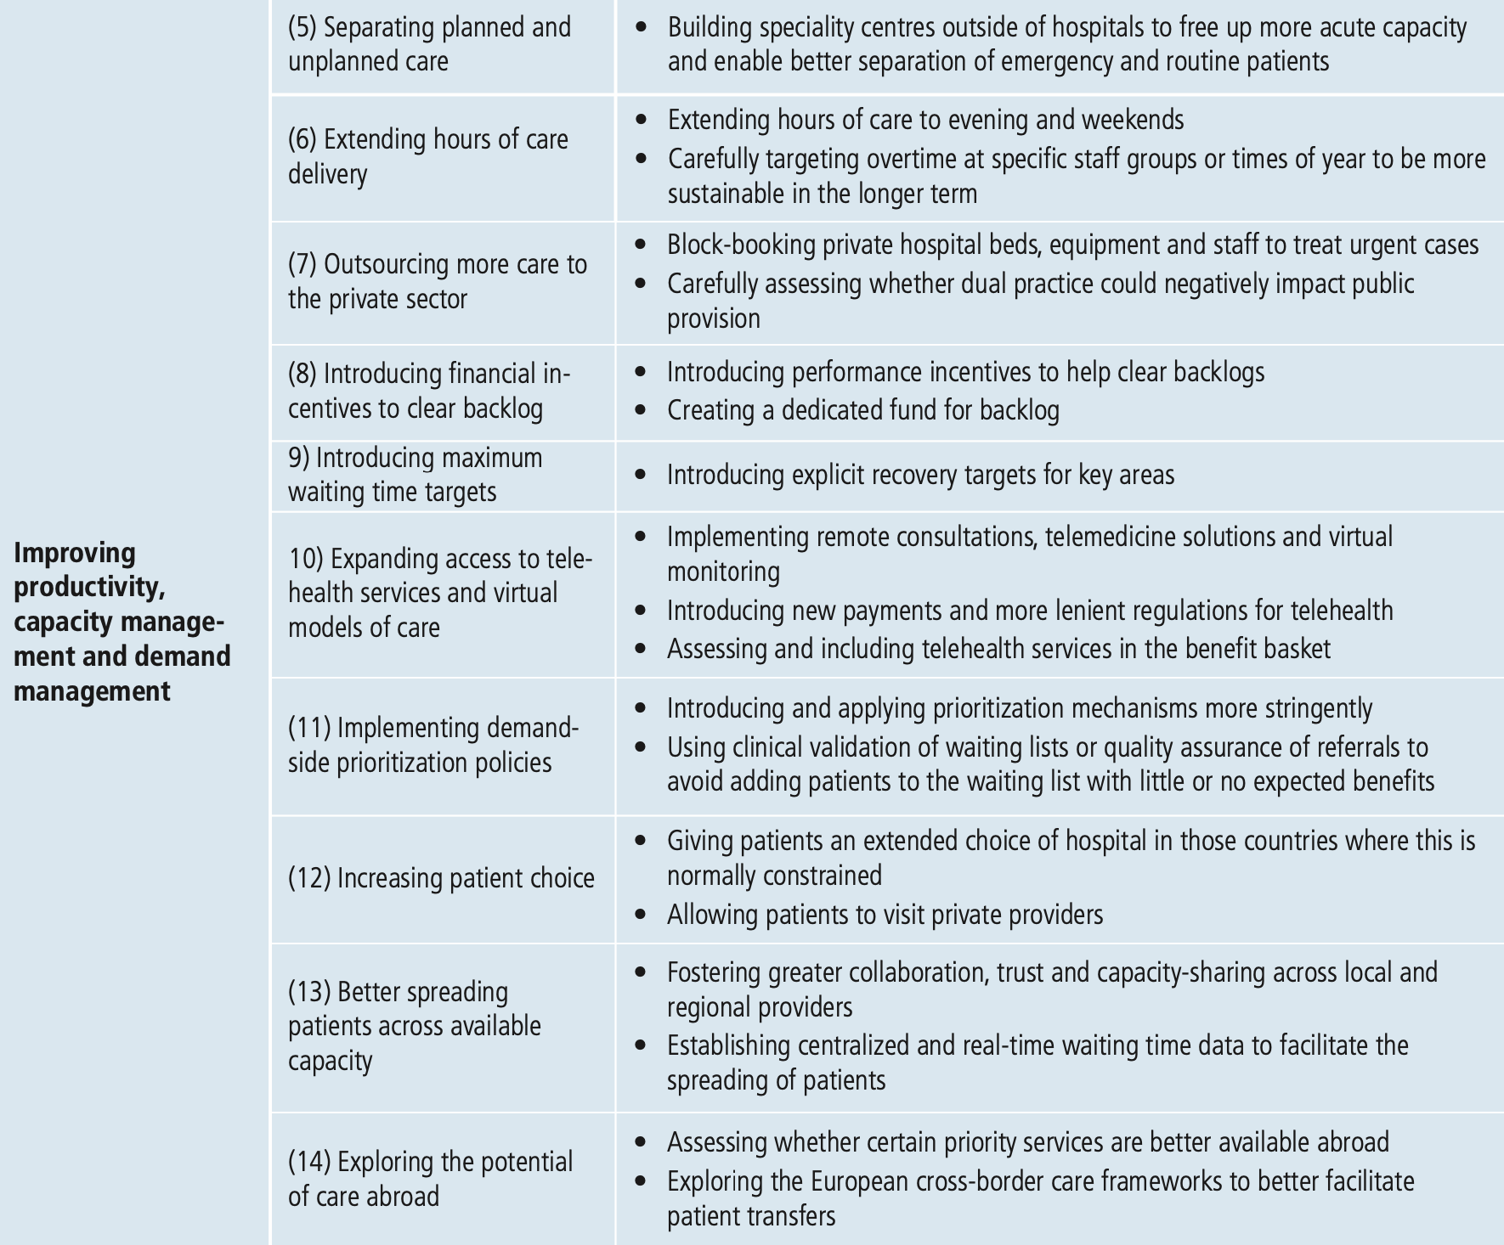
Improving productivity, capacity management and demand management

Slide 12
Improving productivity, capacity management and demand management

Slide 13
Improving productivity, capacity management and demand management

Slide 14
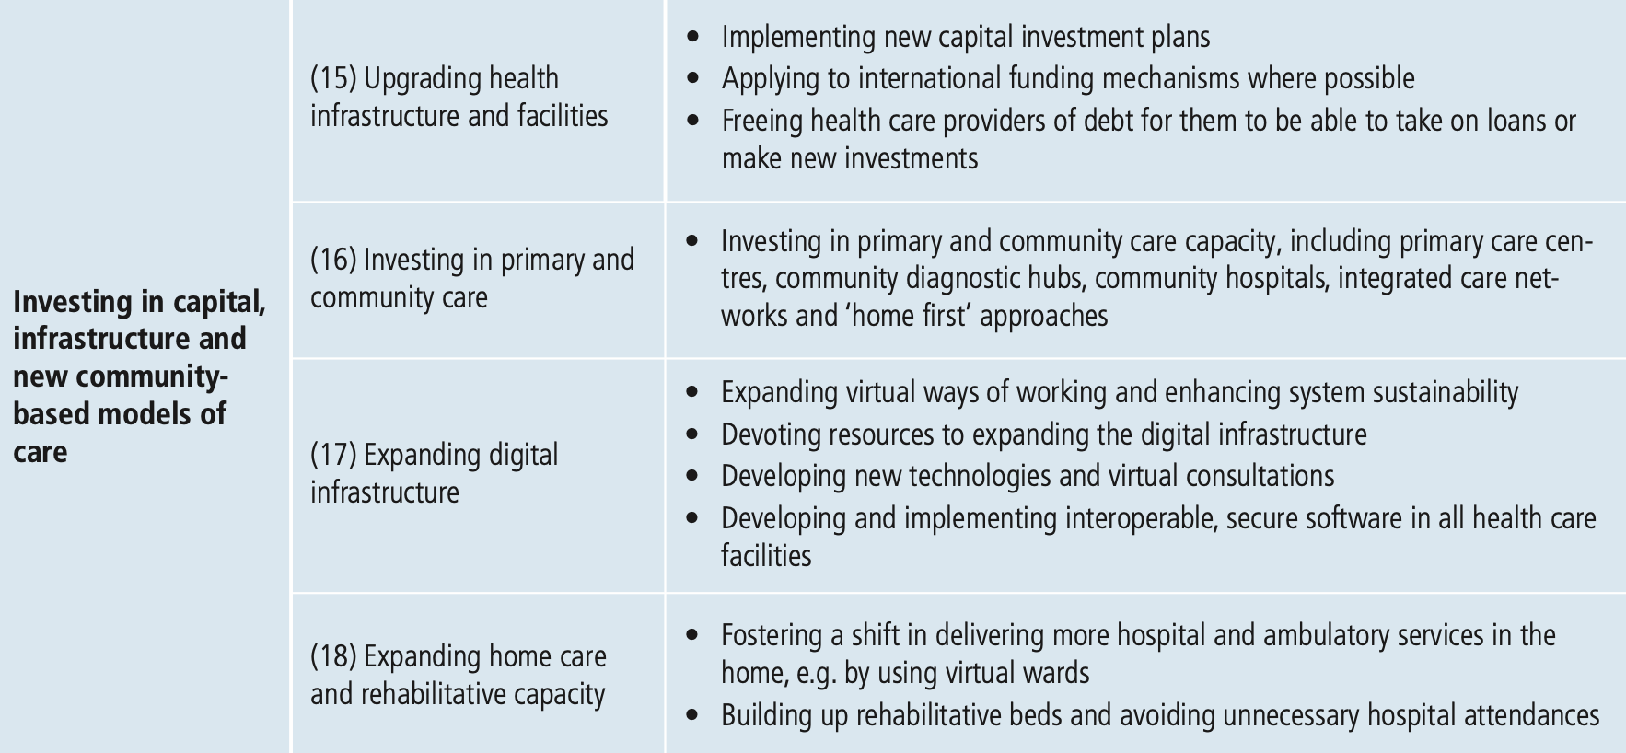
Investing in capital, infrastructure and new community-based models of care

Slide 15
Conclusion
Clearing backlogs is critical for maintaining health gains achieved before the pandemic and avoiding higher mortality
A key requirement is the systematic collection of reliable and meaningful waiting time data, which some countries are not yet doing.
Policies to support and protect health workers should be prioritized but workforce planning and availability remain inadequate in many countries and should also be addressed
It is important that policies to recover from backlog do not inadvertently increase inequalities
Countries should make a strong case for reforms and investment that address long- standing gaps, inefficiencies and inequalities in the health system.

Slide 16


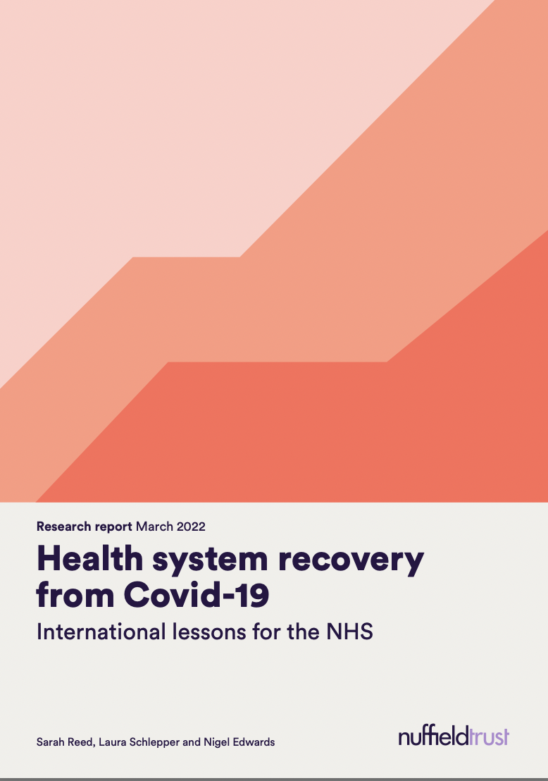
For more information
For future webinars on the topic:
www.tinyurl.com/OBSbacklog
Notes:
Thank you very much for your attention, and thank you to the co-authors, reviewers and group interview participants for the recently launched policy brief
If you are interested in this subject, the Observatory has published related works as well, which I encourage you to check out
Thank you

